Slide 1
Vision and Image Processing: Introductory lecture
D E P A R T M E N T O F C O M P U T E R S C I E N C E U N I V E R S I T Y O F C O P E N H A G E N
Kim Steenstrup Pedersen
Notes:
Forelæsning: 27 personer?
CS: 11
IT & Cognition: 15

Slide 2



The teachers
Kim Steenstrup Pedersen, kimstp@di.ku.dk, DIKU Image Group (course responsible)
Søren Olsen, ingvor@di.ku.dk, DIKU Image Group
Jan Kremer, jan.kremer@di.ku.dk, DIKU Image Group (TA)

Slide 3
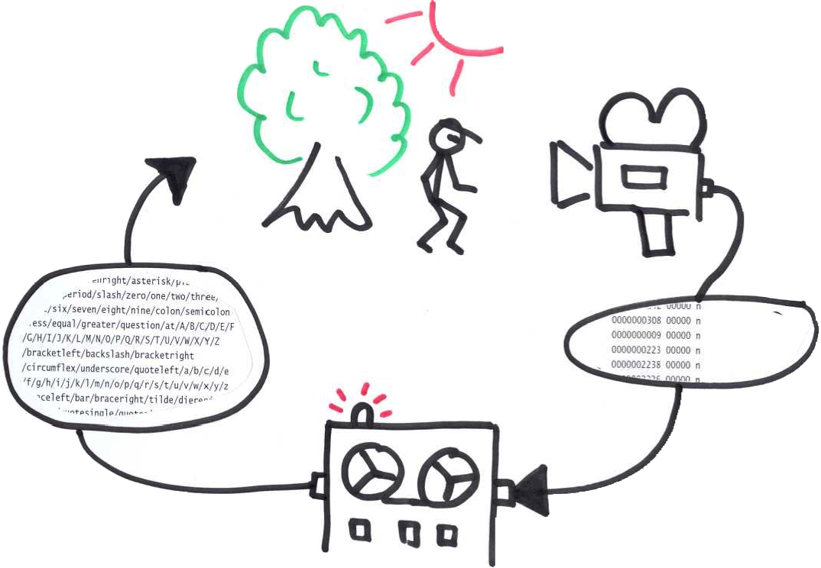
What is this course about?
Computer Vision
Notes:
Scenario: We observe the world through one or more cameras plugged into a computer and we wish to infer a model description/abstract interpretation of the scene.
We focus on some of the hot research topics in Computer Vision.

Slide 4
Definitions of Computer Vision
My definition: The design of algorithms for interpreting visual data by mimicking (and surpassing) the human visual perceptual system.
Alternatives:
McGraw-Hill Science & Technology Dict.: The use of digital computer techniques to extract, characterize, and interpret information in visual images of a three-dimensional world.
Wikipedia: As a scientific discipline, computer vision is concerned with the theory behind artificial systems that extract information from images. The image data can take many forms, such as video sequences, views from multiple cameras, or multi-dimensional data from a medical scanner.
thefreedictionary.com: Field of robotics in which programs attempt to identify objects represented in digitized images provided by video cameras, thus enabling robots to “see.”
Notes:
Notice that the Wikipedia definition includes medical image analysis – this I think is debatable
In my opinion Thefreedictionary is too thin a definition

Slide 5
Tentative plan for lectures
Week | Content
47 | Features I
48 | Features II
49 | Content-Based Image Retrieval (CBIR)
50 | Object detection and recognition
51 | Stereo vision I
2 | Stereo vision II and tracking
3 | Depth from focus and rigid structure from motion

Slide 6
Format
This course consists of:
Lectures on Mondays
A mix of lectures and exercise class on Wednesdays (bring your laptop)
You will work with selected methods in the mandatory assignments.
We suggest that you try to implement and experiment with other methods not covered in the assignments.
Notes:
We plan to spend the last 2 hour of Wednesdays on exercises.

Slide 7
Schedule: When and where?
Lectures + exercises:
Mondays 13:15 – 15:00 in HCØ Aud. 8
Wednesdays 13:15 – 15:00 in HCØ Aud. 8
15:15 – 17:00 in HCØ Aud. 5

Slide 8
Mandatory assignments
The course includes 4 mandatory assignments:
A mix of theoretical and practical problems
You have two weeks to solve each of them
Necessary theory will be presented at lectures
The solutions must be made individually (first) and some in groups (the rest)
You can get help during the lectures and exercise class
You are also welcome to contact the lecturers and TA for help

Slide 9
Students Prerequisites
This course is offered on the M.Sc. educations in It & Cognition and Computer Science.
We assume that you know:
Programming at a basic level (either Python, Matlab, or C/C++)
Basic linear algebra
Be aware:
You are a mixed crowd with different backgrounds!
There might be parts you will find trivial and other parts you won’t.

Slide 10
Relation to other DIKU courses
Signal and image processing, Q1
Extremely useful, but not a requirement for this course
Statistical methods for machine learning, Q3
Excellent companion course
Advanced topics in data modeling, Q4
Good companion course
Medical image analysis, Q2
Related topic
Numerical optimization, Q2
Gives a good foundation in optimization techniques relevant for Computer Vision

Slide 11
How do I pass this course?
You have to pass the 4 mandatory assignments in order to pass this course.
Assignment 1 must be solved individually, but we encourage you to discuss it with your fellow students.
Other assignments can be solved in groups or individually.
In case you do not pass an assignment the first time you will be given a second chance to submit a new solution (Assuming that you have made a SERIOUS attempt the first time).
Final grading for the course is: Pass / Fail based on the assignments.

Slide 12
How much time should I spend on this course?
KU expect that you to use 23 hours / week for a 7.5 ECTS course. Approx. 46 hours/wk for full time study. (Yes, it is more than the 37.5 hours/wk common out in real life, i.e. according to Danish union agreements)
How should I spend my time:
Lectures and exercise classes = 2 + 4 = 6 hours/wk
Preparation and assignment = 23 – 6 = 17 hours/wk
We recommend that you prepare by reading the current weeks material and doing some research on your own, ideally prior to each lecture (approx. 8 hours/wk)
Work on the assignment at home (approx. 9 hours/wk)
Notes:
46 hours! But you have long summer holidays ☺

Slide 13
Course material
We will use a mix of research papers and chapters from selected books.
All material will be made available in Absalon under the Course material menu item.

Slide 14
Relevant software
Choice of programming language: Python, Matlab, C / C++
Matlab is available from KUnet software library for installation on your laptop
You can get quite far in Python using:
Numpy
Scipy
Python Image Library (PIL)
If you prefer C / C++ (or Python), we recommend these libraries:
OpenCV http://opencv.org/
VLFeat http://www.vlfeat.org/
Notes:
Hints will be given with the assignments

Slide 15
How to get help
We use Absalon (access via your KUnet account)
You will find latest lecture plan
Links to lecture slides (usually after the lecture)
Course material (reading material)
Assignments (materials for the assignments)
Links to additional material (reading, programming, etc.)
Discussion board in Absalon for course related topics
Talk with the teachers at class, per e-mail, or try to catch us at our offices

Slide 16
Enough about the formalities!

Slide 17
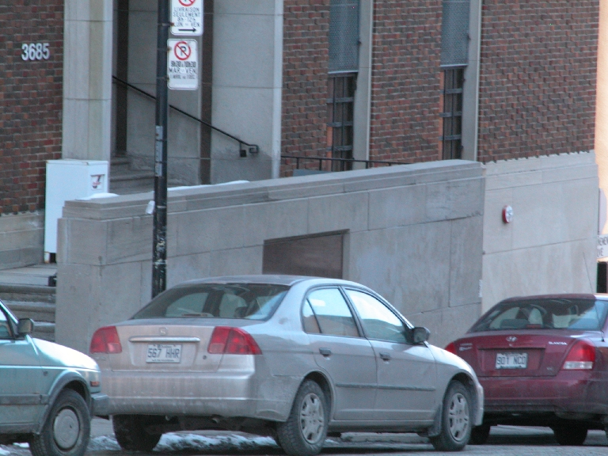
What do you see in this image?
Low level cues: Texture, shading, shadows, occlusion boundaries
High level interpretation: Objects, foreground-background, 3D perception, object affordances
And we did not include motion!
Human analysis of this image is effortless, but how would we do this in a computer?
Notes:
Which objects? Cars, a house, stairs, windows, lamp / sign post
Depth / 2.5D interpretation: Cars in front, lamp post behind car, house behind cars and lamp post
High level semantic interpretation of the scene:
What’s the relationship among the objects? “Cars on road in front of house”
Shadows, high lights, changing colors reveal info about 3D structure: Photometric stereo – shape from shading
Foreground-background: Occlusions reveal information about depth
You’re a priori knowledge / internal model also helps you interpret the scene.
“Road sloping downhill”

Slide 18
A couple of examples of interesting problems in Computer Vision

Slide 19
Example: Object recognition and detection
What is in this image?
And where?
Cars
House
Lamp post
Notes:
Might include localization of the objects
What information do we need here?
Maybe object models?
From detailed to loose models

Slide 20
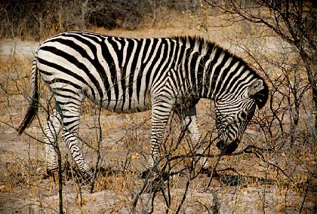
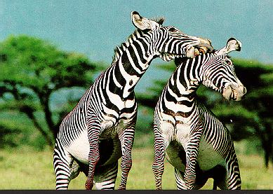
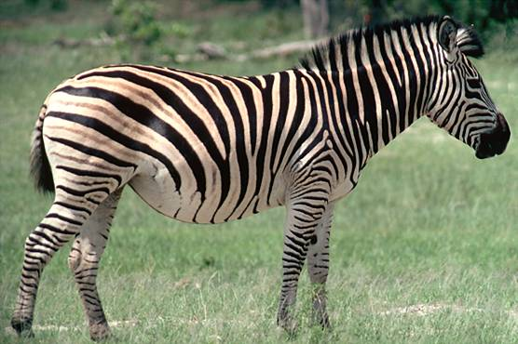
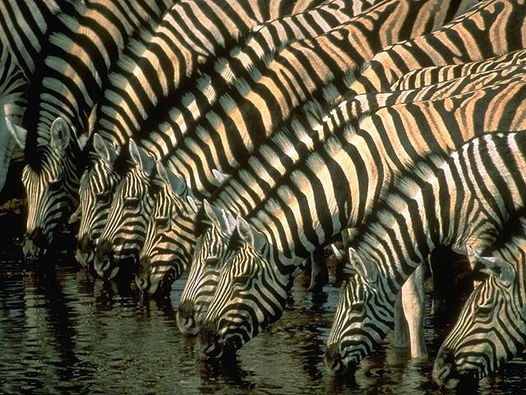
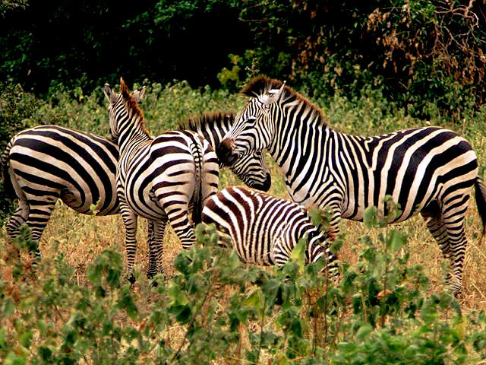
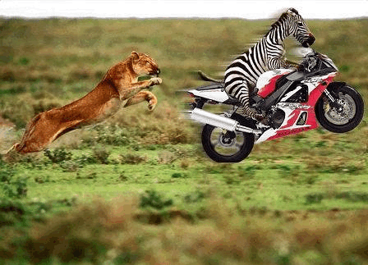
Example: Content-Based Image Retrieval Please return all image that are similar to my query image
Search result
Query image
Notes:
Do we need scene understanding?
This does not necessarily require a complete scene understanding. It can be done solely based on appearance of the dominant objects.

Slide 21
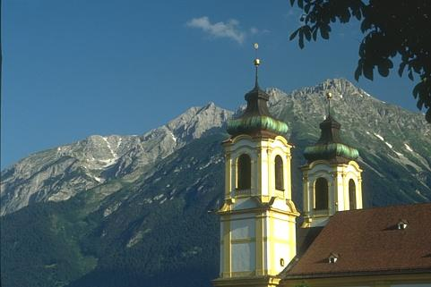

Example (low-level): Image Segmentation Information on object boundaries and parts
Notes:
This can be part of the building blocks for object recognition and scene interpretation. Object boundaries and object parts.

Slide 22
Example: 3D reconstruction Stereo or multi-view
Notes:
This is a classic computer vision problem: 3D understanding of the scene

Slide 23
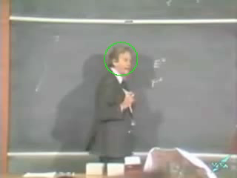
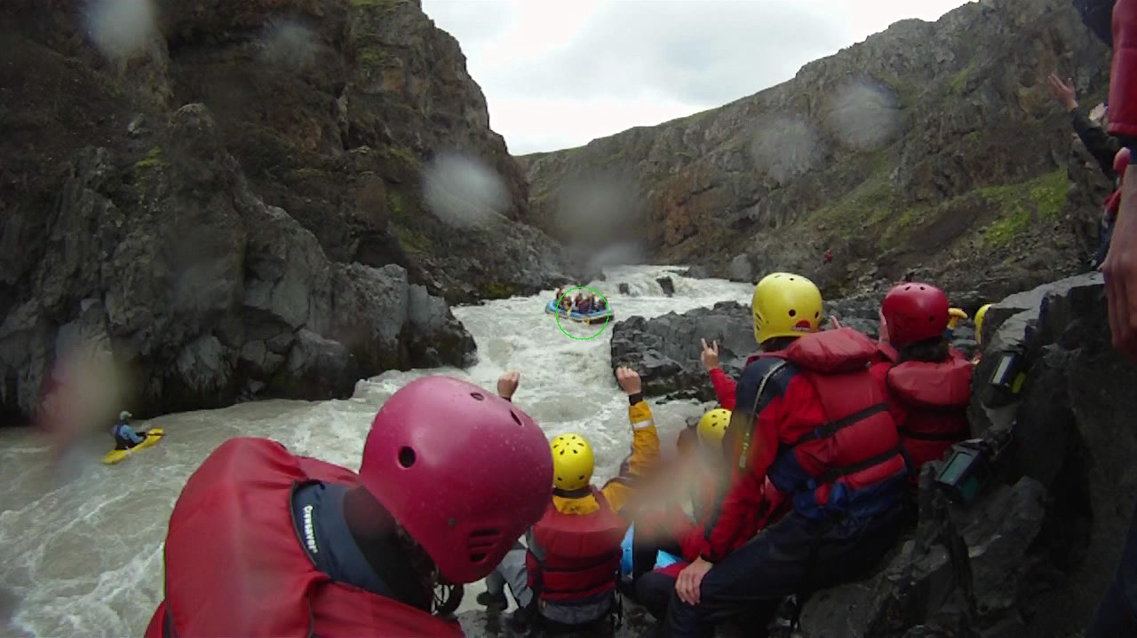
Example: 2D tracking of objects Estimate an objects 2D trajectory in the image over time

Slide 24
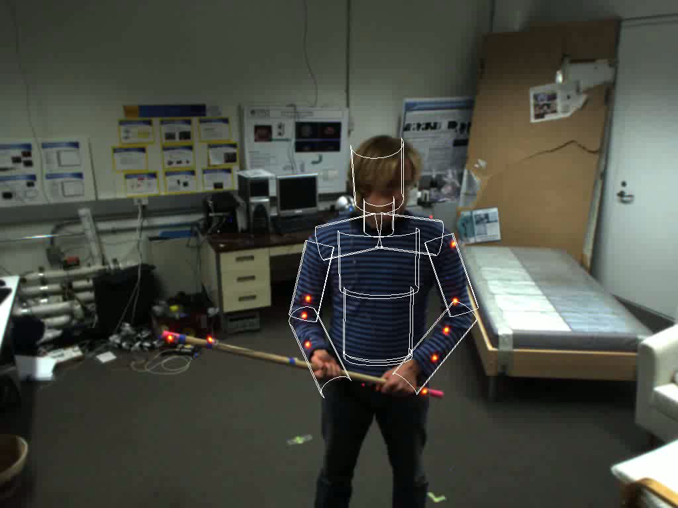
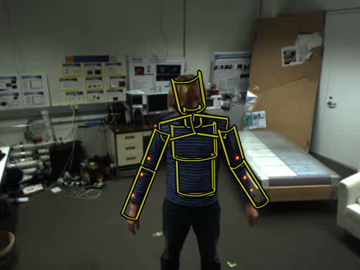
Example: 3D articulated human tracking Estimate 3D pose over time

Slide 25
Lets start from the bottom and go up

Slide 26
Our input data consists of images – so what is an image?

Slide 27
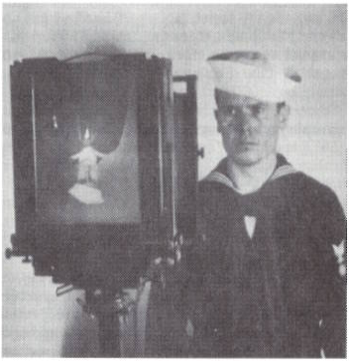
Image formation: Camera obscura / pinhole camera
Notes:
We need a camera and a model of it to understand the process
Camera obscura was the first camera type.
Image plane = photographic glass plate
Image upside-down in this process

Slide 28
Image formation: Camera obscura / pinhole camera
Notice: An image is a 2D projection of the 3D world through a perspective projection
Notes:
Light goes through the pinhole and hits the image plane (film, CCD chip, etc)
It is common in theory to work with the virtual image plane (also common in computer graphics). Otherwise image is upside-down
This is a model of perspective projection

Slide 29
Image formation: Some effects of perspective projection
Objects far away appear smaller than objects close by
Notes:
This particular type of projection process is know as perspective projection. d = Focal length
Here are some consequences
A and C have same height viewed through the pinhole O.
However C is closer to O than A by distance d and will appear as long as B (B is twice as long as A and C)

Slide 30
Image formation: Some effects of perspective projection
Parallel lines appear to cross in the image plane (vanishing point)
Notes:
Move image plane in front to ease the interpretation.
Under perspective projection parallel lines appear to meet and cross (vanishing point) and the vanishing point lie somewhere on a horizontal line.
The vanishing point can be outside the image.

Slide 31
Image formation: Vanishing points
Notes:
Perspective effects gives us information about the 3D structure in the scene. More about this later in the course

Slide 32
Image formation: The pinhole camera model
O : optical center / pinhole
z : optical axis
C’ : image center
f’ : focal length
Notes:
In camera coordinate system: P=(x,y,z) and P’=(x’,y’,z’)
Focal length = brændvidde
f’/z scales the x,y-coordinates- move the object away from O and P’ moves towards C’ and vice versa
We skip lenses, but this also has an effect on the image formation process

Slide 33
Image formation: Field of view of the camera is
Notes:
We view the scene through a limited aperture.
d the diameter of the image / CCD chip / film and f is the focal length
This gives the opposite cone out into the scene
With real-world optics we have the concept Field of depth = the range of depth where objects appear in focus.
More on camera geometry later in this course

Slide 34
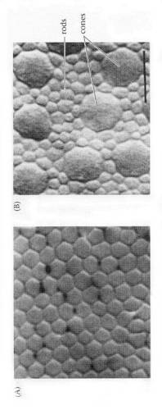
Image formation - Aside note: The human eyes form a stereo camera
Notes:
The pinhole camera is a good analogy of the human eye
Iris is the pinhole
Cornea + lens = optical lens
Cone cells = sensitive to color
Rod cells = high spatial sensitivity, also important for peripheral vision
This is not a course on neurobiology but we will once in a while get inspired by how biological vision systems function. Don’t over do it! We want to build vision systems superior to biological vision ☺

Slide 35
Image formation: The digital camera
Most cameras use charge coupled device (CCD) chip
Notes:
Interpreted as measurements of light energy hitting each photoreceptor cells. This causes a current to flow in the CCD elements that is passed through a analog-to-digital converter giving a collection of numbers representing the amount of light that hit the element.
To get color, it is common to use color sensitive filters and either Bayer masks or 3 CCD chips (RGB)

Slide 36

Image representation: An array of pixels (=picture elements)
Pixel values:
Gray scale (1 integer)
Color (vector)
RGB (3 integers vector)
CMYK (4 integer vector)
…
Notes:
We will think of an image as a function of (x,y) coordinates having intensity values (scalar or vector valued).
In practice it is discritized spatially and intensities are quantized and rescaled to integers.
Notice that it is common to have y axis upside-down – very confusing!

Slide 37
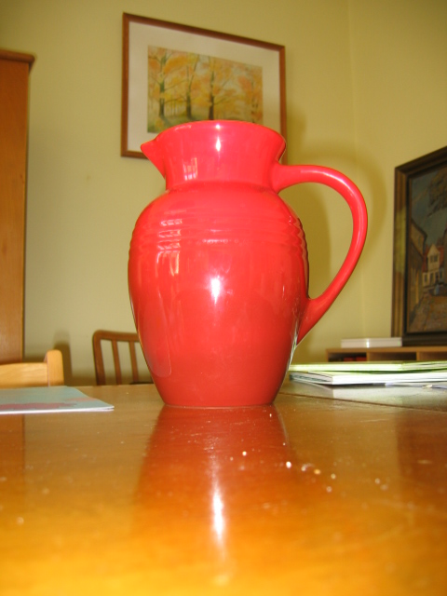
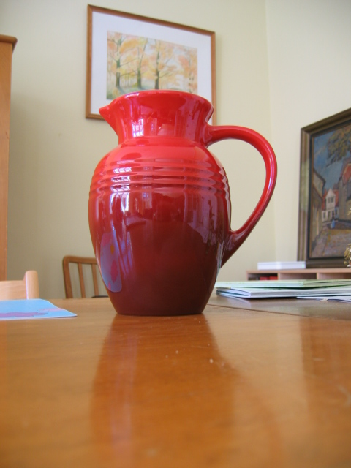
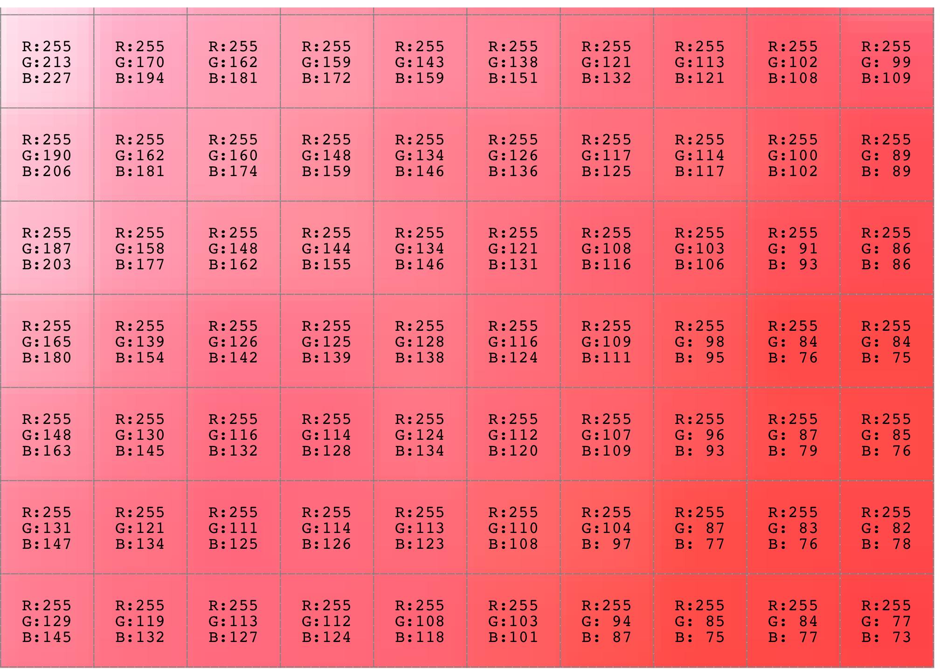

Image representation: An array of pixels (=picture elements)
Notes:
It’s the same red pitcher but the lighting is different (flash versus day light).
Only considering the numbers – these two arrays are different. But it’s the same object!
Our algorithms need to be able to handle differences in lighting and perspective – this is the challenge!
From pixel level to Marr’s primal sketch and higher order abstractions

Slide 38
A bunch of numbers in a table is not enough!

Slide 39
Image representation: Marr’s layers of abstraction (1982)
Abstractions
3D Model
Depth
Orientation
Occlusions
2 1/2D sketch
Primal sketch
Segments
Features
Notes:
We actually don’t always need a full 3D model. Many recognition methods is solely based on models of local appearance of the objects. (e.g. DPM’s)
Once we have this hierarchy in place (or at least partially) we can solve some vision tasks!

Slide 40
Color, Shading and Shadows also concerns us
Notes:
Shading = material reflectance properties and how color changes
Notice the cast shadows and how the texture of the roof changes dramatically.
We need methods that are robust to this kind of variation!

Slide 41
We need to refine this hierarchy of abstractions!
This is the topic of this course
Notes:
More on this hierarchy later in the course

Slide 42
Mandatory assignment 1: Feature extraction
Notes:
Many computer vision problems requires feature extraction, e.g. 3D reconstruction

Slide 43
Mandatory assignment 1: Feature extraction
Build and experiment with interest point detectors
Find matching points between two images
Notes:
Notice that new regions appear while others are occluded or go out of view.
Start by installing software and make this run before Wednesday!

Slide 44
Summary
Examples of computer vision problems
Image formation:
Pinhole camera model
We skip models for lenses
The human eye is a “camera”
Image representation:
At the bottom: Digital images as an array of pixels
Marr’s layers of abstraction

Slide 45
Literature
Reading material:
Forsyth and Ponce: Ch. 1
Additional material:
David Marr: Vision. W. H. Freeman & Company, 1982
Notes:
There is also a new 2012 version of the Forsyth & Ponce book that we recommend if you like some additional material.

Slide 46

Annual satisfaction and well-being assessment: UCPH is investigating the study environment. Tell us how we can improve your study environment! Remember to answer the survey by 3 December. You will recieve a link to the survey via your UCPH e-mail (KU-mail), read more about the assessment at KUnet. Thank you for your response ☺
A word from our sponsors …

